Slide 1
NumPy in Python

Slide 2
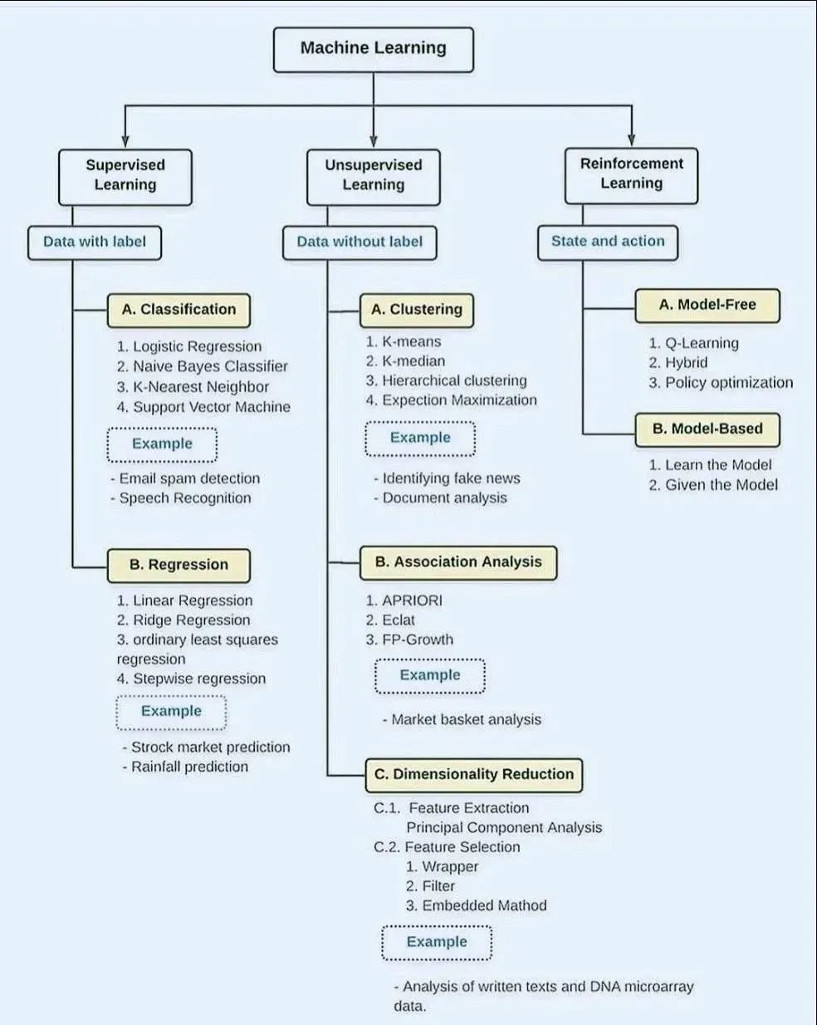
Notes:
https://duchesnay.github.io/pystatsml/?fbclid=IwY2xjawKa2K1leHRuA2FlbQIxMABicmlkETFhamhndWZaRUx0OUhDbHZuAR7c4E_fh_u1hWYYEGk8y7jvtt8dUCjoSbdS1810-X-9FKQhTMHAtxsHhlj9Ng_aem_cOhVFv3wpA203Ly7jeWVdw

Slide 3
What is NumPy?
Python NumPy is a general-purpose array processing package which provides tools for handling the n-dimensional arrays.
It contains various features:
N-dimensional array object
Sophisticated functions
Useful linear algebra, Fourier transform, Matrix etc..

Slide 4
NumPy’s main object is the homogeneous multidimensional array.
It is a table of elements (usually numbers), all of the same type, indexed by a tuple of positive integers.
In NumPy dimensions are called axes.
The number of axes is rank.
NumPy’s array class is called ndarray.
It is also known by the alias array.
[[[10 20]
[30 40]
[50 60]]
[[15 25]
[35 45]
[55 65]]]

Slide 5
The important characteristics of an array are:
Each element of the array is of same data type, though the values stored in them may be different.
The entire array is stored contiguously in memory. This makes operations on array fast.
Each element of the array is identified or referred using the name of the Array along with the index of that element, which is unique for each element.
The index of an element is an integral value associated with the element, based on the element’s position in the array.
For example consider an array with 5 numbers: [ 10, 9, 99, 71, 90 ]

Slide 6
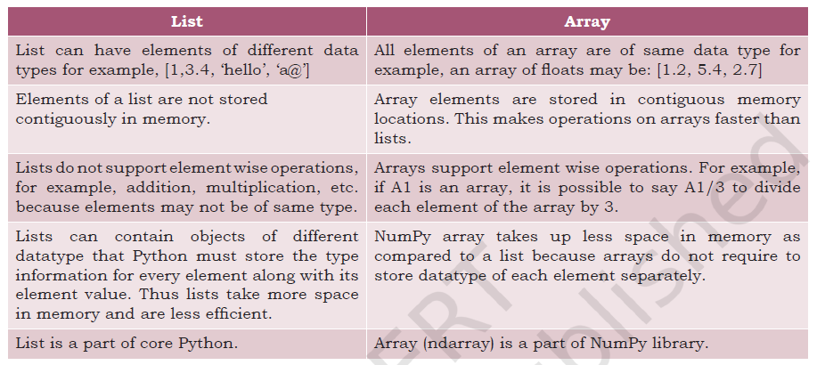

Slide 7
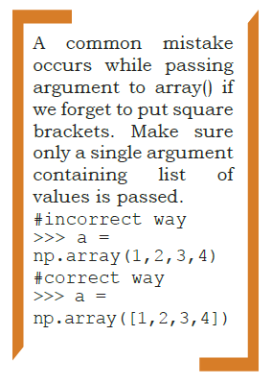
Creation of NumPy Arrays from List
To create an array and to use its methods, first we need to import the NumPy library.
import numpy as np
The NumPy’s array() function converts a given list into
an array.
A = np.array( [10,20,30] )
Print(A)

Slide 8
Creating a 1-D Array
An array with only single row of elements is called 1-D array.
Let us try to create a 1-D array from a list which contains numbers
A = np.array( [10,20,30] )
Print(A)

Slide 9

Creating a 2-D Array
We can create a two dimensional (2-D) arrays by passing nested lists to the array() function.
A = np.array( [ [10,20,30], [40,50,60] ] )
Print(A)

Slide 10
Attributes of NumPy Array
ndarray.ndim
ndarray.shape
ndarray.size
ndarray.dtype
ndarray.itemsize

Slide 11
ndarray.ndim
Gives the number of dimensions of the array as an integer value. Arrays can be 1-D, 2-D or n-D. In this chapter, we shall focus on 1-D and 2-D arrays only. NumPy calls the dimensions as axes (plural of axis). Thus, a 2-D array has two axes. The row-axis is called axis-0 and the column-axis is called axis-1. The number of axes is also called the array’s rank.
A = np.array( [ [10,20,30], [40,50,60] ] )
Print(A.ndim)

Slide 12

ndarray.shape
It gives the sequence of integers indicating the size of the array for each dimension.
A = np.array( [ [10,20,30], [40,50,60] ] )
print(A.shape)

Slide 13
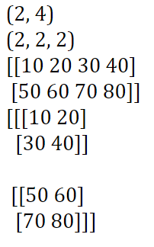
A = np.array( [ [10,20,30,40], [50,60,70,80] ] )
B = A.reshape(2,2,2)
print(A)
print(B)

Slide 14
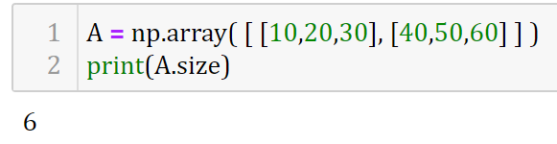
ndarray.size
It gives the total number of elements of the array. This is equal to the product of the elements of shape.

Slide 15
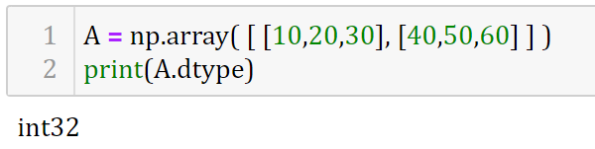
ndarray.dtype
The data type of the elements of the array. All the elements of an array are of same data type. Common data types are int32, int64, float32, float64, U32, etc.

Slide 16
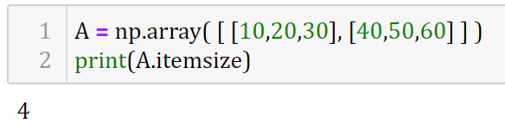
ndarray.itemsize
It specifies the size in bytes of each element of the array. Data type int32 and float32 means each element of the array occupies 32 bits in memory. 8 bits form a byte. Thus, an array of elements of type int32 has itemsize 32/8=4 bytes. Likewise, int64/float64 means each item has itemsize 64/8=8 bytes.

Slide 17
Other ways of creating NumPy Array

Slide 18
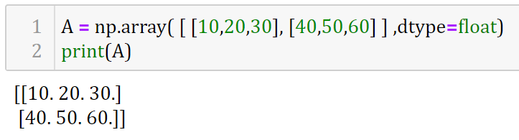
We can specify data type (integer, float, etc.) while creating array using dtype as an argument to array()

Slide 19
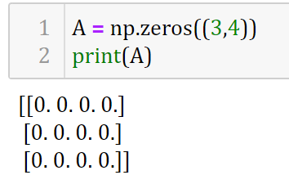
We can create an array with all elements initialised to 0 using the function zeros(). By default, the data type of the array created by zeros() is float.

Slide 20
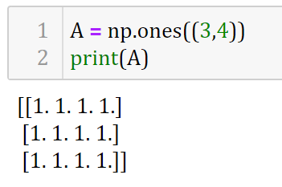
We can create an array with all elements initialised to 1 using the function ones().

Slide 21
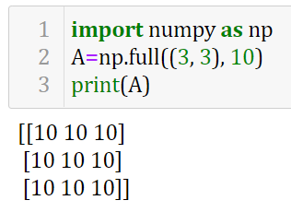
We can Create a 3x5 array filled with a specific value for ex. 10 using np.full()

Slide 22
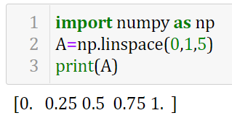
We can Create an array of five values evenly spaced between two values using np.linspace()

Slide 23
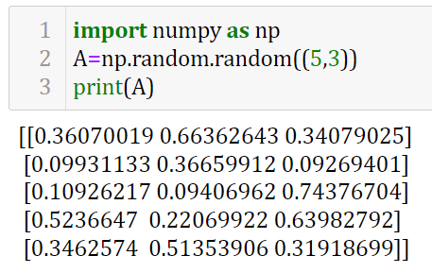
We can Create an array of uniformly distributed random values between 0 and 1 using np.random.random()

Slide 24
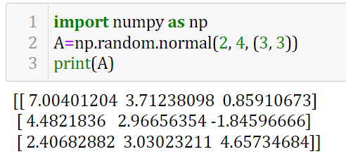
We can Create an array of normally distributed random values with mean x and standard deviation y using np.random.normal()

Slide 25
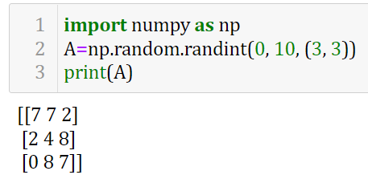
We can Create an array of random integers in the interval (x,y) using np.random.randint()

Slide 26
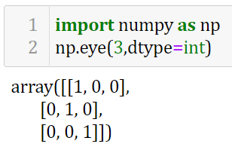
We can Create an identity matrix using np.eye()

Slide 27
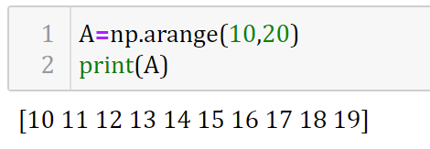
ndarray.arange(start,stop)

Slide 28
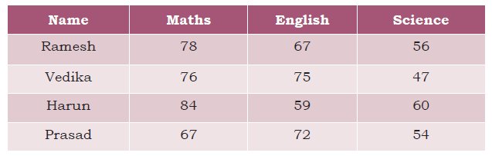
Indexing and Slicing
Indexing
Let us create an array called marks to store marks given in three subjects for four students given in this table.

Slide 29
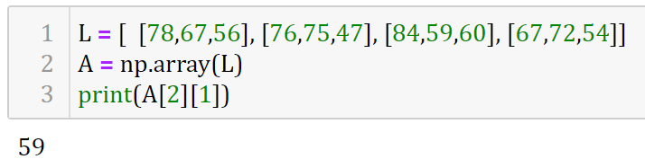
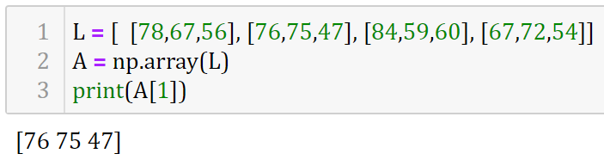
Retrieving second element from third row
Retrieving second row

Slide 30
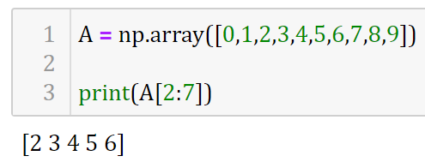
Slicing
Sometimes we need to extract part of an array. This is done through slicing.
We can define which part of the array to be sliced by specifying the start and end index values using [start : stop : step] along with the array name.
Retrieving 3rd to 7th elements

Slide 31
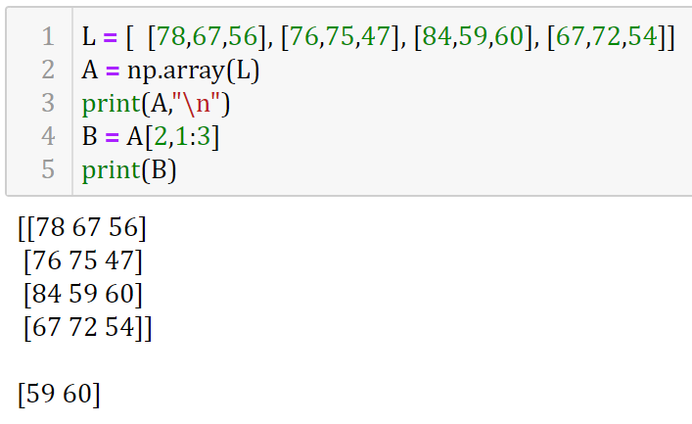
Retrieving two elements from 3rd row

Slide 32
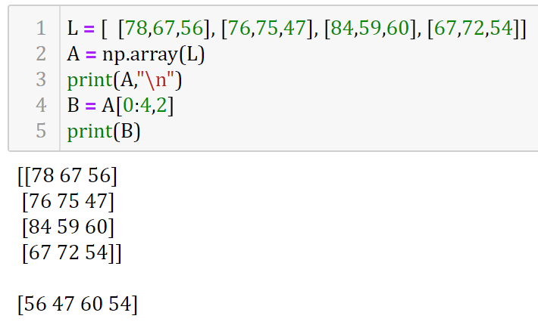
Retrieving third column

Slide 33
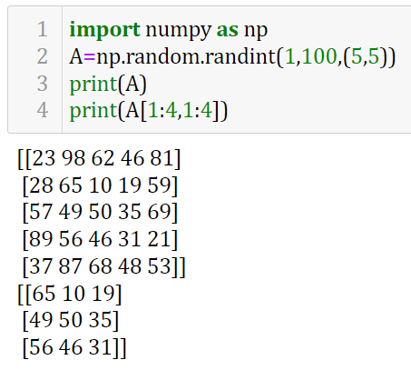
Retrieving inner 3*3 Matrix

Slide 34
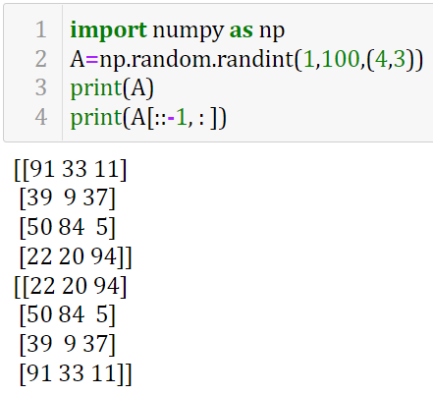
Row wise reverse

Slide 35
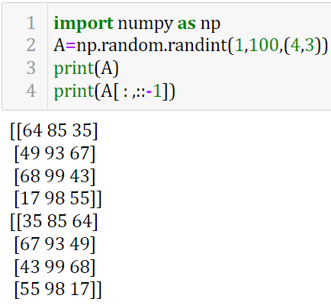
Col. wise reverse

Slide 36
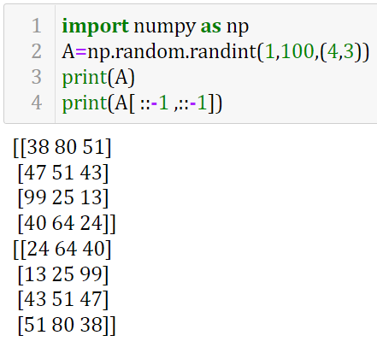
At a time both
Row wise and Col. wise reverse
It is equal to
180 degree rotation

Slide 37
Concatenating Arrays
Concatenation means joining two or more arrays. Concatenating 1-D arrays means appending the sequences one after another.
NumPy.concatenate()
This function can be used to concatenate two or more 2-D arrays either row-wise or column-wise.
All the dimensions of the arrays to be concatenated must match exactly except for the dimension or axis along which they need to be joined.
Any mismatch in the dimensions results in an error.
By default, the concatenation of the arrays happens along axis=0.

Slide 38
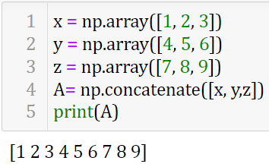
Example1: concatenating x,y,z Arrays and assigning to A

Slide 39
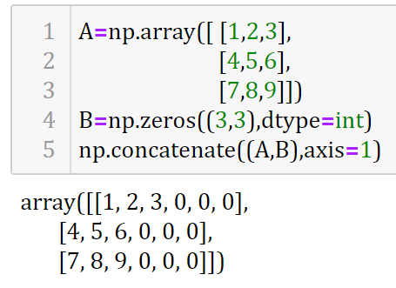
Example2: Row wise concatenation of B to A

Slide 40
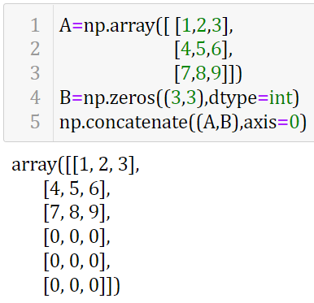
Example3: Col. wise concatenation of B to A

Slide 41
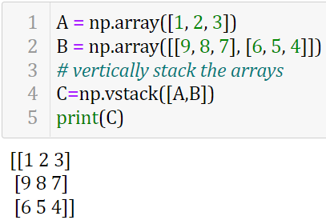
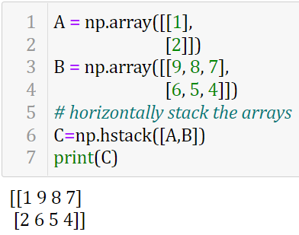
Example4,5: np.vstack (vertical stack) and np.hstack (horizontal stack)
For working with arrays of mixed dimensions, it can be clearer to use the np.vstack (vertical stack) and np.hstack (horizontal stack) functions:

Slide 42
Splitting Arrays
We can split an array into two or more sub-arrays.
numpy.split() splits an array along the specified axis.
We can either specify sequence of index values where an array is to be split; or we can specify an integer N, that indicates the number of equal parts in which the array is to be split, as parameter(s) to the numpy.split() function.

Slide 43
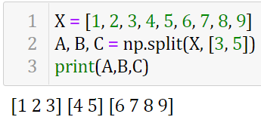
Example1: Splitting 1-D Array

Slide 44
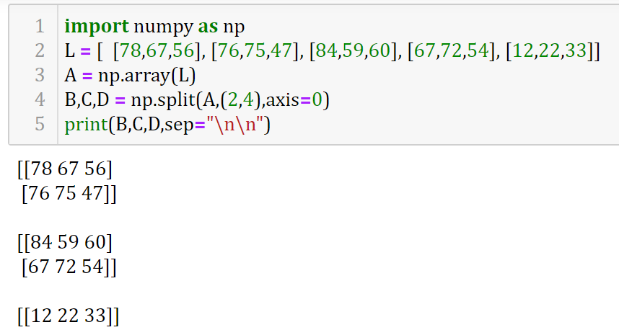
Example2.1: Splitting 2-D Array
numpy.split()
Row wise with axis=0

Slide 45
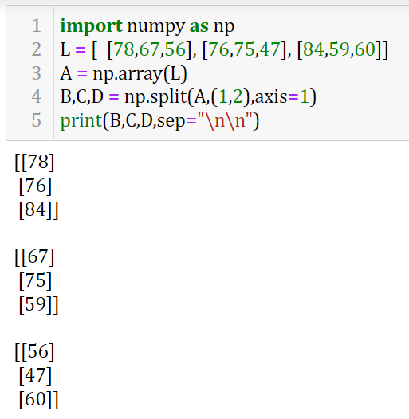
Example2.2: Splitting 2-D Array
numpy.split()
Column wise with axis=1

Slide 46
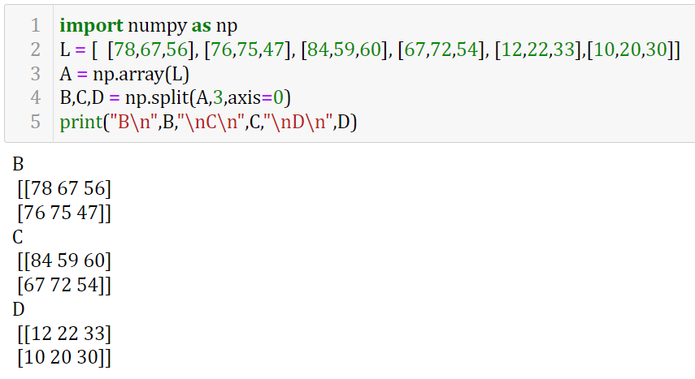
Example2.3: Splitting 2-D Array
numpy.split()
Equal partitions Row wise with axis=0

Slide 47
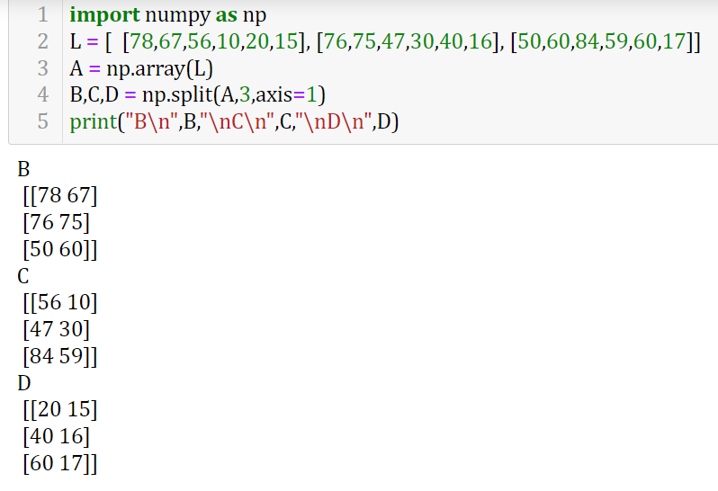
Example2.4: Splitting 2-D Array
numpy.split()
Equal partitions Col. wise with axis=1

Slide 48
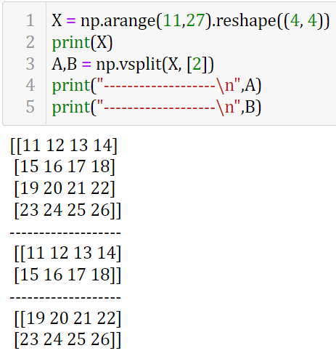
Example3.1:
Splitting 2-D Array using np.vsplit

Slide 49
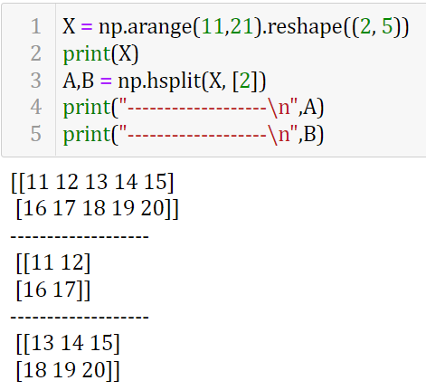
Example3.2:
Splitting 2-D Array using np.hsplit

Slide 50
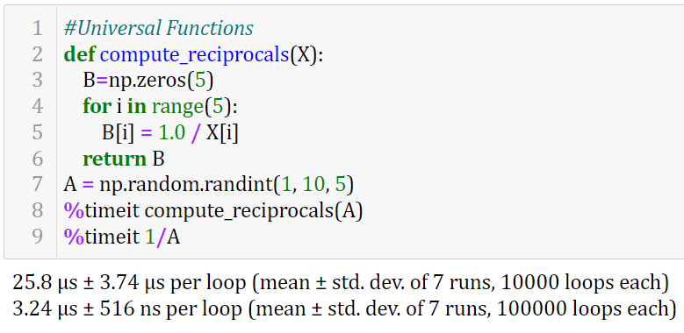
Introducing NumPy's Universal functions

Slide 51
NumPy's Ufuncs - Arithmetic Operations
Operator | Equivalent ufunc | Description
+ | np.add() | Addition (e.g., 1 + 1 = 2)
- | np.subtract() | Subtraction (e.g., 3 - 2 = 1)
- | np.negative() | Unary negation (e.g., -2)
* | np.multiply() | Multiplication (e.g., 2 * 3 = 6)
/ | np.divide() | Division (e.g., 3 / 2 = 1.5)
// | np.floor_divide() | Floor division (e.g., 3 // 2 = 1)
** | np.power() | Exponentiation (e.g., 2 ** 3 = 8)
% | np.mod() | Modulus/remainder (e.g., 9 % 4 = 1)

Slide 52
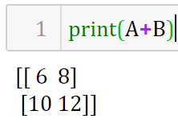
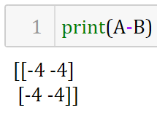
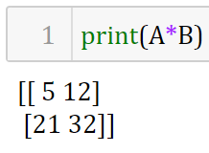
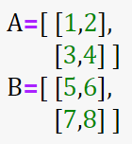
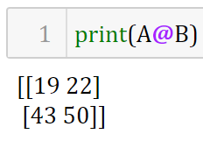
Arithmetic Operations on Arrays –Exploring NumPy's UFuncs
When we perform a basic arithmetic operation like addition, subtraction, multiplication, division etc. on two arrays, the operation is done on each corresponding pair of elements.
Matrix Multiplication
/, //, %, ** will also work

Slide 53
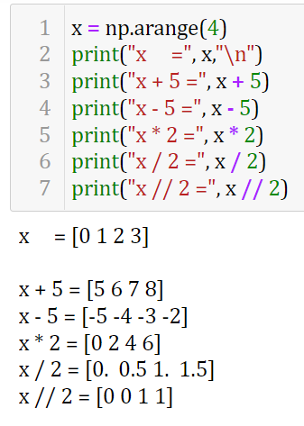

Slide 54
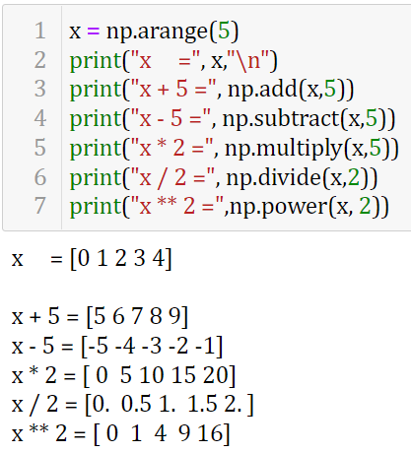

Slide 55
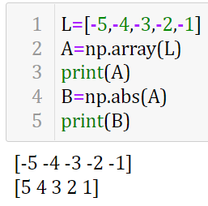
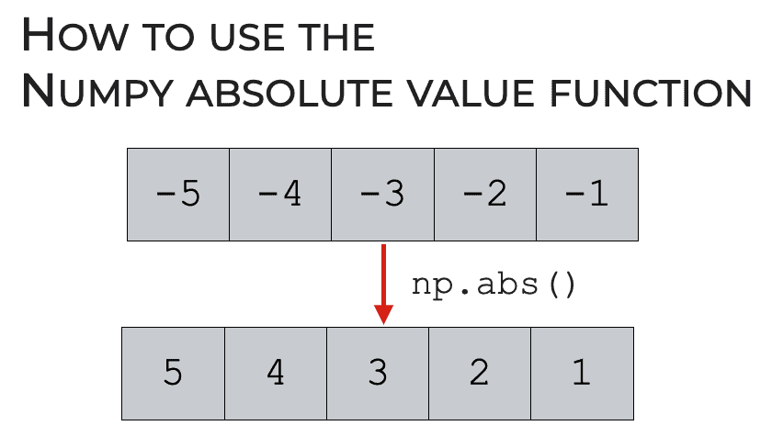
Absolute value
The corresponding NumPy ufunc is np.absolute, which is also available under the alias np.abs

Slide 56
Absolute value – on complex numbers
The corresponding NumPy ufunc is np.absolute, which is also available under the alias np.abs
x = np.array([3 - 4j, 4 - 3j, 2 + 0j, 0 + 1j])
np.abs(x)
[5. 5. 2. 1.]

Slide 57
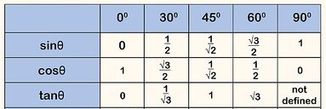
Trigonometric functions
NumPy provides a large number of useful ufuncs, and some of the most useful for the data scientist are the trigonometric functions.
We’ll start by defining an array of angles

Slide 58


Slide 59

Exponents

Slide 60

Logarithms

Slide 61


Advanced ufuncs features
Specifying output

Slide 62

Aggregates

Slide 63



Outer function few more examples

Slide 64

Aggregations

Slide 65

Because it executes the operation in compiled code,
NumPy’s version of the operation is computed much more quickly

Slide 66


Summing the Values in an Array

Slide 67



Slide 68


Sum of each column

Slide 69


Sum of each row

Slide 70

Aggregation
functions
available in
NumPy

Slide 71


Sorting
In 2-D array, sorting can be done along either of the axes i.e., row-wise or column-wise. By default, sorting is done row-wise (i.e., on axis = 1). It means to arrange elements in each row in ascending order. When axis=0, sorting is done column-wise, which means each column is sorted in ascending order.

Slide 72


Comparison Operators as ufuncs

Slide 73

How to understand Boolean Arrays?
In Boolean arrays, False is interpreted as 0, and True is interpreted as 1

Slide 74

Masking

Slide 75







Bitwise Operators

Slide 76

Matrix Transpose
We use np.transpose(Array). We can aslo use np.T(A)
Matrix Transpose

Slide 77
Broadcasting: Computation on Arrays
Broadcasting is simply a set of rules for applying binary ufuncs (addition, subtraction, multiplication, etc.) on arrays of different sizes.

Slide 78


A is (2,3)
B is (1,3)
A+B is (2,3)
A is (1,3)
B is (3,1)
A+B is (3,3)

Slide 79


A is (1,2)
B is (3,1)
A+B is (3,2)
A is (1,4)
B is (3,1)
A+B is (3,4)

Slide 80
Rules of Broadcasting
Broadcasting in NumPy follows a strict set of rules to determine the interaction between the two arrays:
Rule 1: If the two arrays differ in their number of dimensions, the shape of the one with fewer dimensions is padded with ones on its leading (left) side.
Rule 2: If the shape of the two arrays does not match in any dimension, the array with shape equal to 1 in that dimension is stretched to match the other shape.
Rule 3: If in any dimension the sizes disagree and neither is equal to 1, an error is raised.

Slide 81


Slide 82
NumPy’s Structured Arrays
If we have several categories of data on a number of people (say, name, age, and weight).
It would be possible to store these in three separate arrays:
name = ['Alice', 'Bob', 'Cathy', 'Doug']
age = [25, 45, 37, 19]
weight = [55.0, 85.5, 68.0, 61.5]
NumPy can handle this through structured arrays: Using a compound data type for structured arrays
data = np.zeros(4, dtype={'names':('name', 'age', 'weight'), 'formats':('U10', 'i4', 'f8')})
data = np.zeros(4, dtype=[('name','U10'), ('age',int), ('weight',float)])

Slide 83
NumPy’s Structured Arrays
Now that we’ve created an empty container array, we can fill the array:
data['name'] = name
data['age'] = age
data['weight'] = weight
print(data)
Output:
[('Alice', 25, 55.0) ('Bob', 45, 85.5) ('Cathy', 37, 68.0) ('Doug', 19, 61.5)]
Now we can refer to values either by index or by name.

Slide 84

NumPy data types

Slide 85
Advanced Compound Types
We can create a type where each element contains an array or matrix of values.
Example: a data type with a mat component consisting of a 3×3 floating-point matrix:
tp = np.dtype([('id', 'i8'), ('mat', 'f8', (3, 3))])
X = np.zeros(1, dtype=tp)
print(X[0])
print(X['mat'][0])
Output:
(0, [[0.0, 0.0, 0.0], [0.0, 0.0, 0.0], [0.0, 0.0, 0.0]])
[[ 0. 0. 0.]
[ 0. 0. 0.]
[ 0. 0. 0.]]

Slide 86
RecordArrays: Structured Arrays with a Twist
NumPy also provides the np.recarray class, which is almost identical to the structured arrays just described, but with one additional feature: fields can be accessed as attributes rather than as dictionary keys.
But, there is some extra overhead involved in accessing the fields.

Slide 87

Example

